Slide 1
WEB
Web
Name : Ahmed Essam Youniss
Gpa: 2.00
IS –essam@gmail.com
Section : 1
Name : Noura jamal
Section : 6

Slide 2
Title :
simple comtente managment

Slide 3
Description
User can
-search any existence section and show its Content
-like our page in Facebook
-search our location in the map - only admin can create new section o content

Slide 4
Functions : select
Technologies : Html – Css –Java script -Php

Slide 5
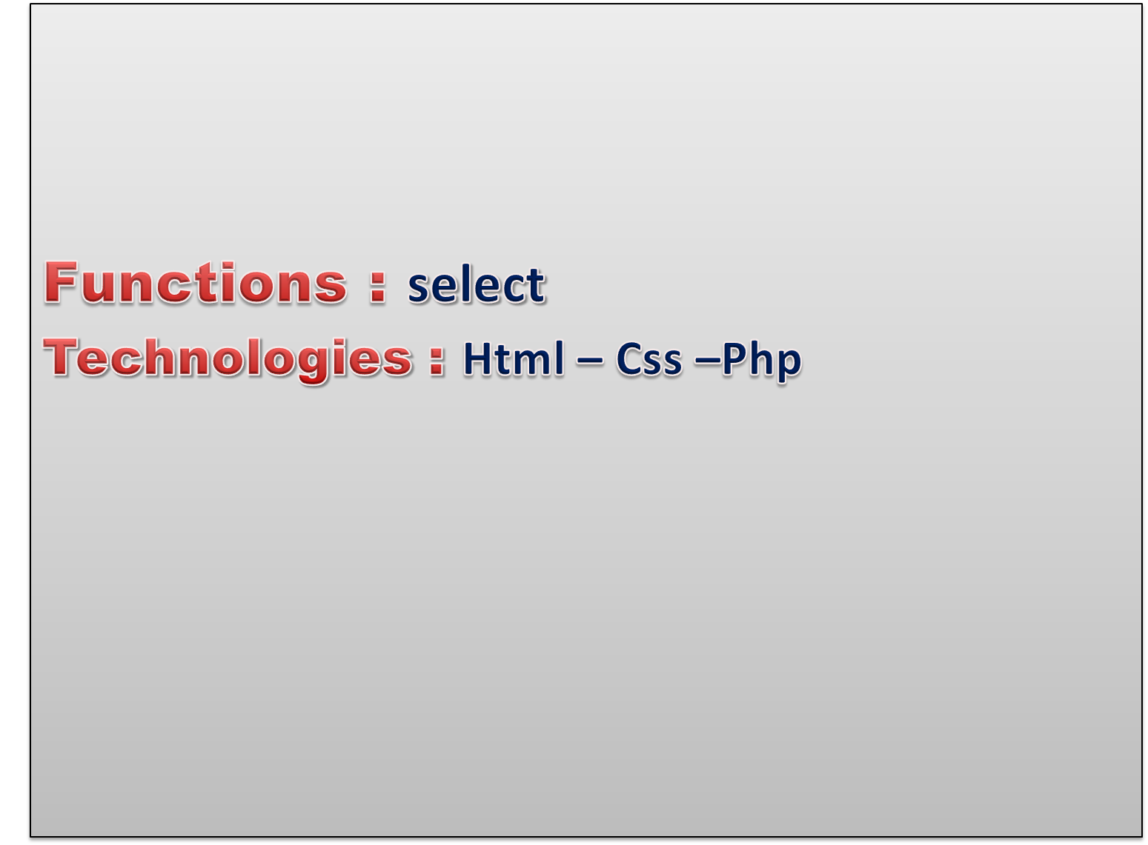
Codes :
Cs::
table{
margin-right:4px;
width:100%;
height:100%;
color:maroon;
background:silver;
text-align:center;
}

Slide 6
Codes :
<form name="formcmnt" method="post" action="comment.php">
<textarea name="comments" rows="1" cols="50%" style="resize: none; margin:0px 0px 3px 10px;"></textarea>
<input type="submit" style="margin:0px 0px 3px 10px; border:none;" name="comment" value="Comment"/>
</form>

Slide 7
Codes : <?php
if(isset($_GET['id'])){
$query="SELECT id,title,body FROM newsportal WHERE id=".$_GET['id'];
$result=mysql_query($query,$conn);
while($row=mysql_fetch_array($result)){
?>
<h3><?php print ucwords($row[1]); ?></h3>
<p><?php print $row[2]; ?></p>

Slide 8
project link:
https://github.com/AsmaaMa7moud/book?fbclid=IwAR19TUt8Z8RERQQWZTYjqhQFZxpNRPal-Ef3Cb_h3V5EkdO2ZhIZg5taAqo

